Slide 1
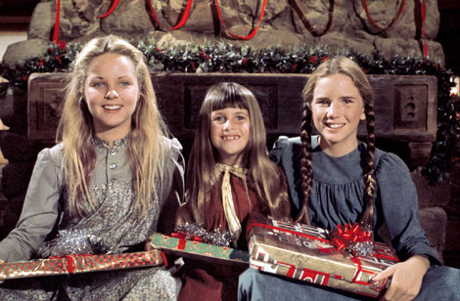
Visit www.lhp.yolasite.com to see for yourself all the cool ways to celebrate Christmas with the Ingalls family!

